Slide 1
Microsoft Imagine Access 2016-2017 Academic Year Introduction
Notes:
Robert Collcott
Microsoft Student Partner
@ Buckinghamshire New University
2016 2017

Slide 2
What is Imagine Access?
Free Software Online platform
Simple search for Microsoft Imagine
Downloadable software

Slide 3
How to Access

Slide 4
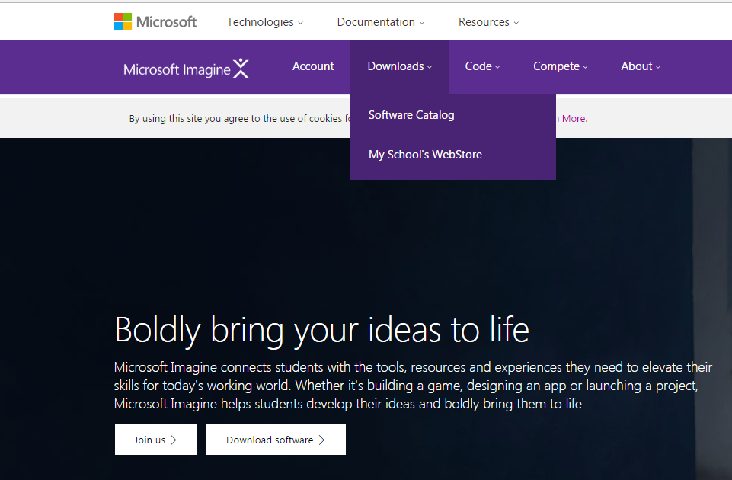
Accessing Bucks’s Imagine Access Subscribed Web Store
Step 1 Type to search for Microsoft Imagine
Step 2 My School’s webstore
Step 3 type in full Buckinghamshire New University and select it then press visit the webstore
Notes:
4 simple steps then going to watch the video of how to do it fully I made this myself on my home machine

Slide 5
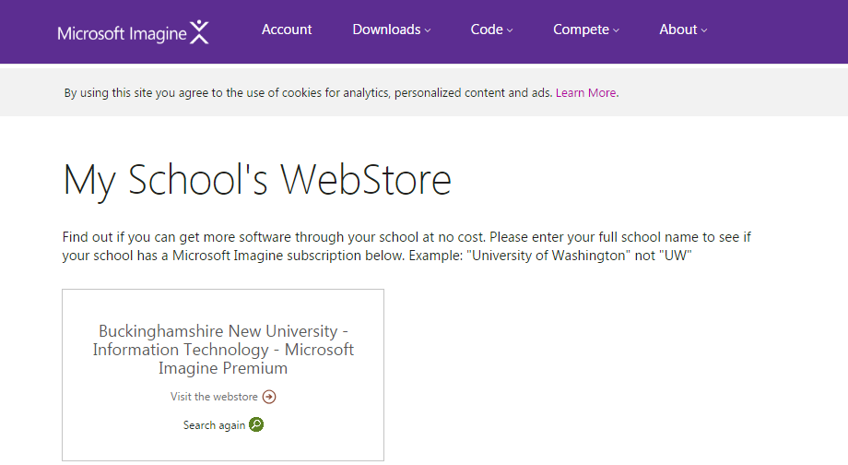
Accessing Bucks’s Imagine Access Subscribed Web Store
Step 1 Type to search for Microsoft Imagine
Step 2 My School’s webstore
Step 3 type in full Buckinghamshire New University and select it then press visit the webstore
Notes:
4 simple steps then going to watch the video of how to do it fully I made this myself on my home machine

Slide 6
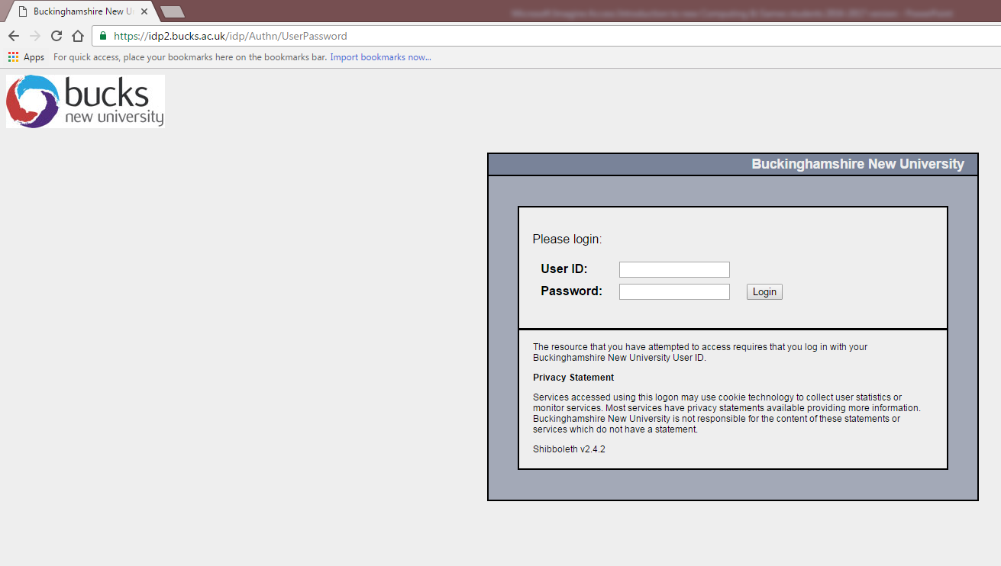
Accessing Bucks’s Imagine Access Subscribed Web Store
Notes:
4 simple steps then going to watch the video of how to do it fully I made this myself on my home machine

Slide 7
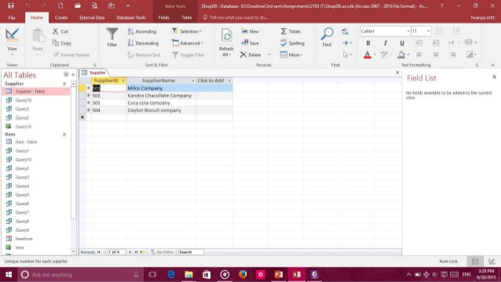
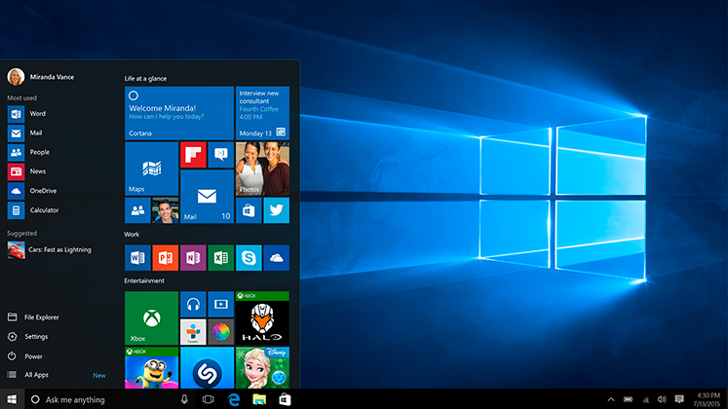
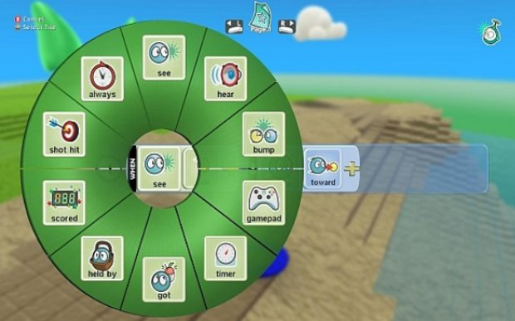
Software on offer to you
University Imagine Access Premium Subscription entitles you to all this free software
Games software for home use E.g. The Uni’s Kodu Game Lab
Some Office software E.g. Access 2016
Free operating systems

Slide 8
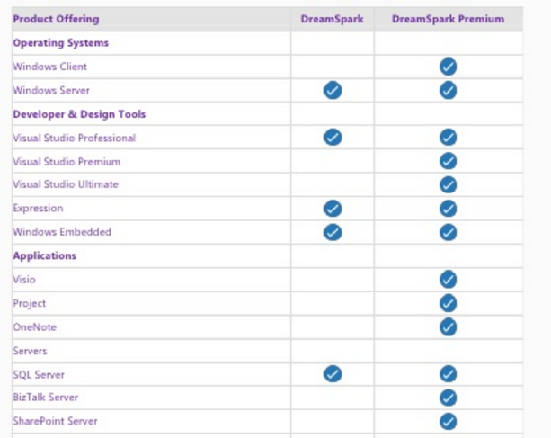
Software on offer to you cont
Imagine
Imagine Premium
Notes:
From Lee Stott’s brochure who I happen to have met at the 2015 Imagine Cup UK National Finals @ TVP

Slide 9
SECURE DOWNLOAD MANAGER PROGRAM POINT
Install this first time you download a piece of software from Imagine Access
First download install this when done then you can run the downloaded program installer
When you have Secure Download Manager installed when downloading programs you just need to download the SDX file which is just the program installer or ISO image

Slide 10
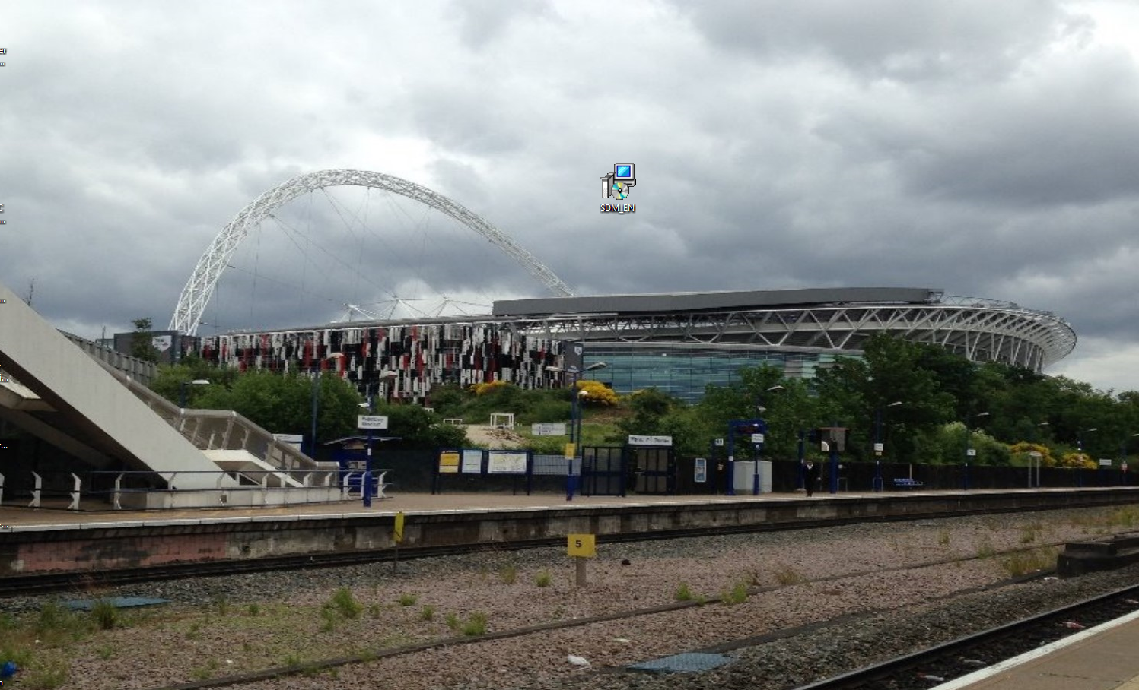
SECURE DOWNLOAD MANAGER POINT INSTALLER YOU’RE WILL GET
Notes:
Save the installer

Slide 11
Further help
Presentation is going on blackboard and also a little pamphlet is going to be available on blackboard in PDF format
Tells you everything you need to know about Imagine Access

Slide 12
The help booklet close up
Page 1 Front Cover
Page 2 inside
The information
Notes:
At the end of the talk I will give these out

Slide 13
Final points and Summary
When you have Secure Download Manager installed when downloading programs from Imagine Access
You just need to download the SDX file which is just the program installer or the program could be an ISO image installer
Enjoy and make the most of Imagine Access

Slide 14
Reference of Links you need
BNU Imagine Access Subscription
https://catalog.imagine.microsoft.com/en-us/catalog/webstore
BNU Imagine Access Webstore front end
https://e5.onthehub.com/WebStore/ProductsByMajorVersionList.aspx?ws=01766602-594a-e411-9403-b8ca3a5db7a1&vsro=8
Notes:
Make a note of these links

Slide 15
Thanks for listening Any Questions
Notes:
Make a note of these links

